Slide 1
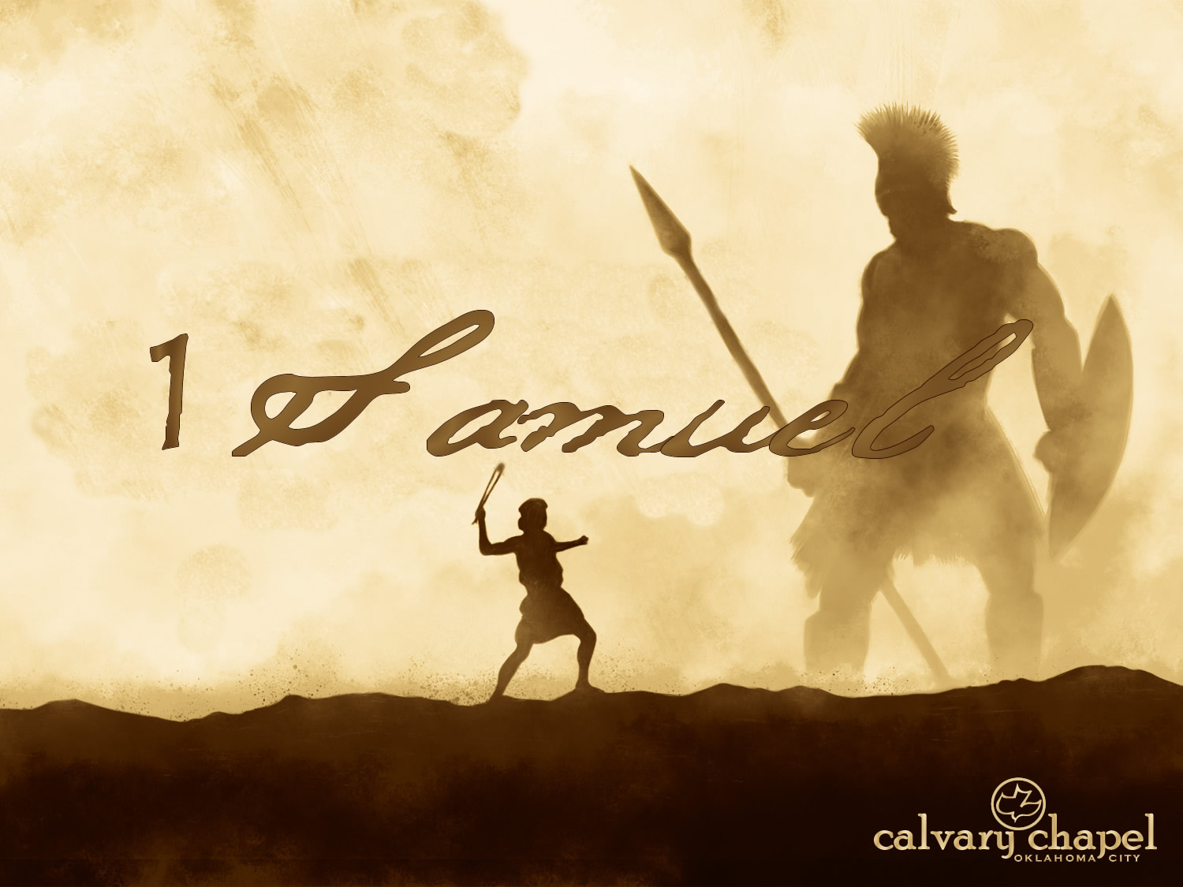

A CD of this message will be available (free of charge) immediately following today's message
This message will be available via podcast later this week at calvaryokc.com
01-02

Slide 2
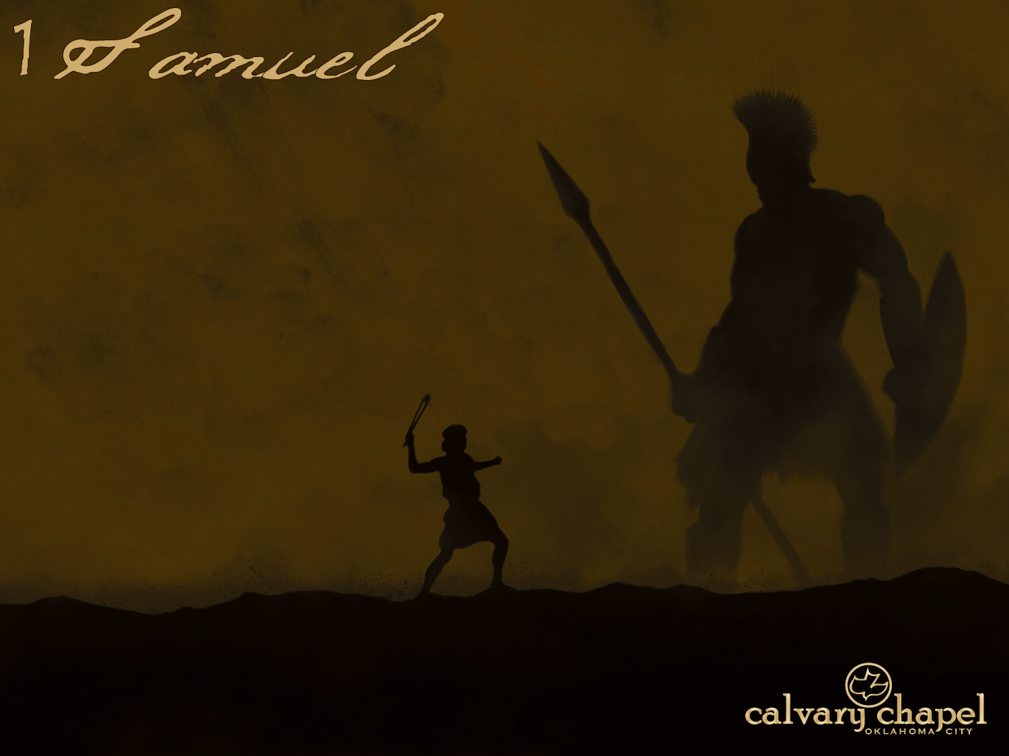
01-02
Samuel ~ His name is God
Author unknown
1 Sam. 11:8, 17:52 and 18:16 recognize Israel and Judah as separate nations
1 and 2 Samuel originally one work

Slide 3
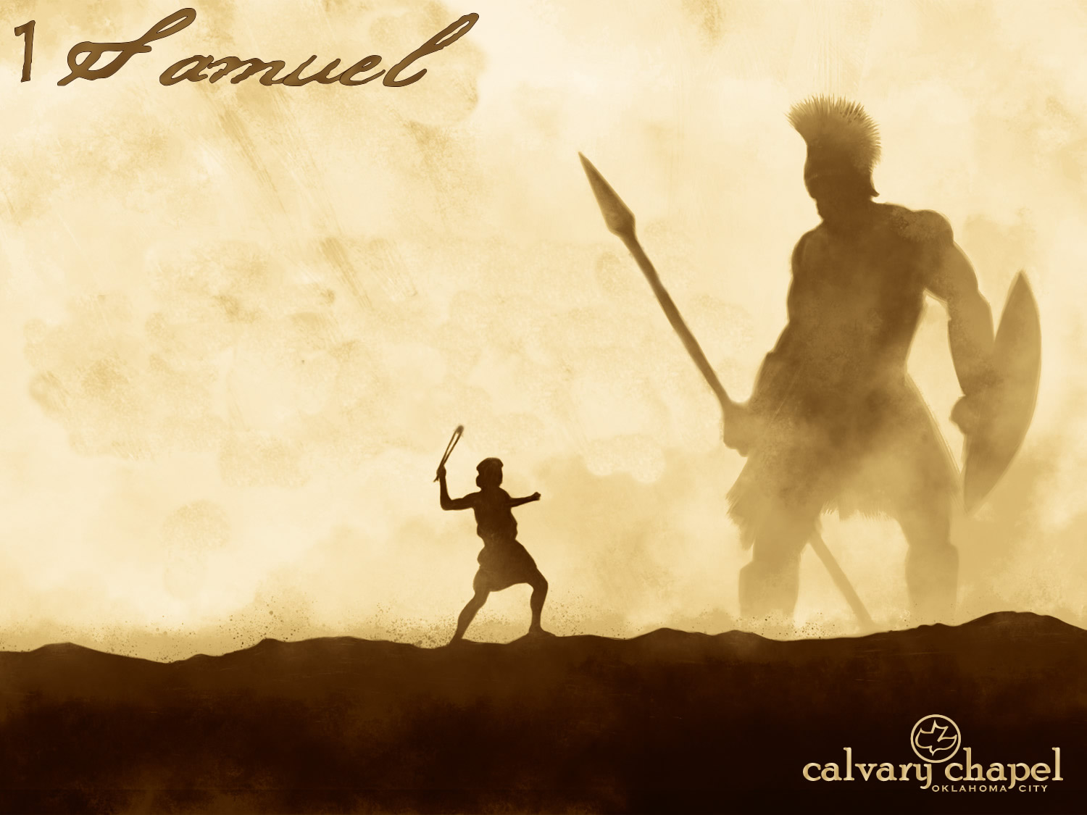
01-02

Slide 4
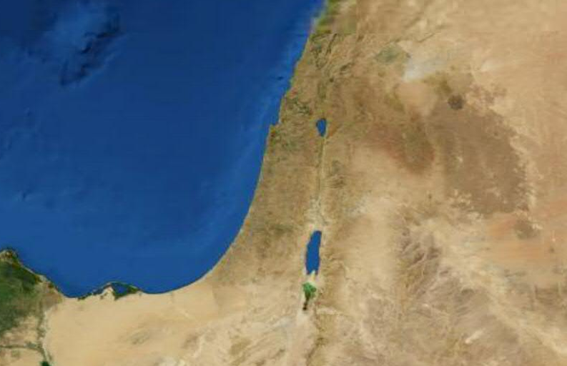
01-02
Ramathaim Zophim
Jerusalem

Slide 5
01-02

Slide 6
01-02
Ramathaim Zophim
Shiloh
Jerusalem

Slide 7
01-02

Slide 8
01-02
Double ~ KJV, worthy

Slide 9
01-02

Slide 10
01-02
Tabernacle ~ hēkal – NIV, NASB ~ Temple – the sense of a large public place

Slide 11
01-02

Slide 12
01-02
Weaned ~ gamal - dealt fully with

Slide 13
01-02

Slide 14
01-02
Lent ~ better as NASB, dedicated

Slide 15
01-02

Slide 16
01-02
Anointed ~ mashiach – Messiah
John 20:29 ~ Jesus said to him, "Thomas, because you have seen Me, you have believed. Blessed are those who have not seen and yet have believed."

Slide 17
01-02

Slide 18
01-02
Corrupt ~ literally, sons of belial

Slide 19
01-02

Slide 20
01-02
John Trapp ~ “Boiled meat would not content them. But it ill becometh a servant of the Lord to be a slave to his palate. Christ biddeth his apostles when they come into a house, ‘eat such things as are set before them,’ if wholesome, though but homely . . . Commonly a wanton tooth is the harbinger to luxurious wantonness. Gluttony is the gallery that lechery walketh through.”

Slide 21
01-02

Slide 22
01-02
Lev. 7:34 ~ For the breast of the wave offering and the thigh of the heave offering I have taken from the children of Israel, from the sacrifices of their peace offerings, and I have given them to Aaron the priest and to his sons from the children of Israel by a statute forever.

Slide 23
01-02

Slide 24
01-02
John Trapp ~ “Draw near hither, ye sons of the sorceress, the seed of the adulterer and the whore . . . ye degenerate brood and sons of Belial, and not of Eli; ye brats of fathomless perdition . . . It is stark stinking naught that I hear, and woe is me that I yet live to hear it; it had been better that I had died long since, or that you had been buried alive, than this to live and stink above the ground.”

Slide 25
01-02

Slide 26
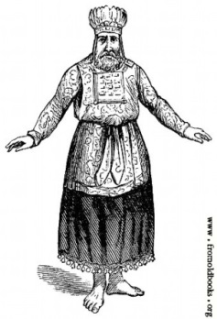
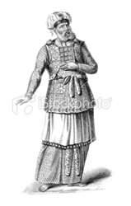
01-02
Aaron
Eleazar
Ithamar
Eli
Nadab & Abihu
Zadok

Slide 27
01-02

